Slide 1
FISH STOCK ASSESSMENT DATA AND MODELS AND THE RESULTING BIOLOGICAL REFERENCE POINTS USED IN FISHERIES MANAGEMENT
Joseph T. DeAlteris
University of Rhode Island
Kingston, RI

Slide 2
Purpose
Summarize the fundamental concepts related to stock assessment data and models, and application of the resulting reference points

Slide 3
Presentation Outline
Background literature
Definitions used in conjunction with reference points
Data – models and the resulting reference points with examples from stock assessments
Harvest control laws
Summary and conclusions

Slide 4
Background Literature
Caddy, J.F., 1998. A short review of precautionary reference points and some proposals for their us in data poor situations. FAO Fisheries Technical Paper No. 379. 22p.
Caddy, J.F. and R. Mohon. 1995. Reference points for fisheries management. FAO Fisheries Technical Paper No. 347. 83 p.
Rosenberg, A.A., P. Mace, G. Thompson et al. 1998. Scientific review of definitions of overfishing in the U.S. Fishery Management Plan. National Marine Fisheries Service.
Rosenberg, A.A. and V.R. Restrepo. 1994. Uncertainty and risk evaluation in stock assessment advice of U.S. marine fisheries. Canadian Journal of Fisheries and Aquatic Sciences 51:2715-2720.
Smith, S.J., J.J. Hunt, and D. Rivard. 1993. Risk evaluation and biological reference points for fisheries management. Can. Spec. Publ. Fish. Aquatic Sci. No. 120. 442 p.

Slide 5
Some Definitions Used in Conjunction with Reference Points
Overfishing – when the current level of fishing mortality exceeds a specified level that allows for sustainable production.
Overfished – when the stock biomass is below a minimum level necessary to maintain the stock at a sustainable level.

Slide 6
Some Definitions Used in Conjunction with Reference Points
(cont.)
Target – reference point where the state of the stock and/or level of fishing is desirable to maintain sustainable production.
Threshold (limit) – reference point where the state of the stock and/or a level of fishing is undesirable to maintain a sustainable production.

Slide 7
Some Definitions Used in Conjunction with Reference Points
(cont.)
Uncertainty – error in both the observation of data and in the formulation of the models used to characterize processes.
Risk – the quantification of the degree to which the probability of particular events occurring that may be undesirable
Precautionary Approach – given uncertainty it is then appropriate to manage conservatively.

Slide 8
Index Data
Catch per unit effort (CPUE) is a proxy for fish abundance
Fishery dependent CPUE data requires standard effort data and complete landings data, only tracks resources available to the fishery.
Fishery independent CPUE (survey) data is useful for many stages in the life history of fish stock.

Slide 9
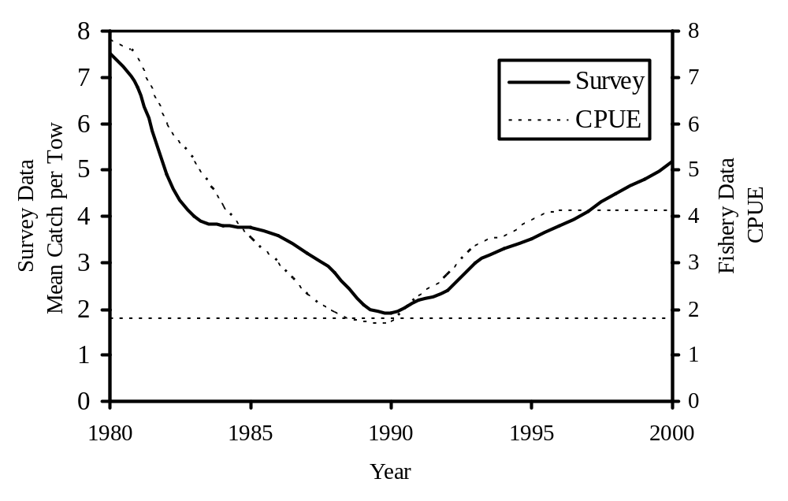
Indices of Relative Abundance Based on Survey and Fishery Data

Slide 10
Examples of Index Data from Fish Stock Assessments
Longfin squid
Georges Bank flounder
Goosefish

Slide 11
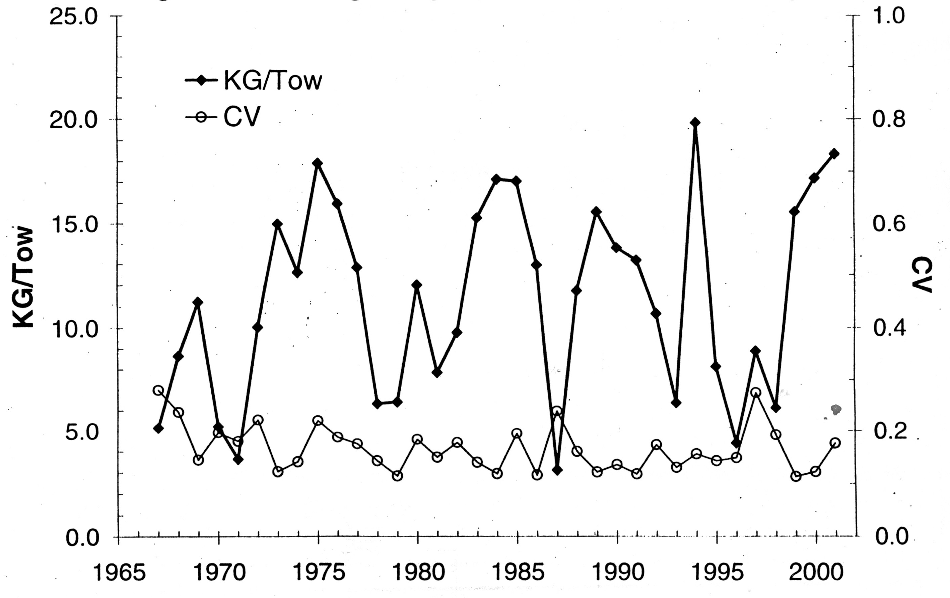
NEFSC Fall Survey Index for Longfin Squid

Slide 12
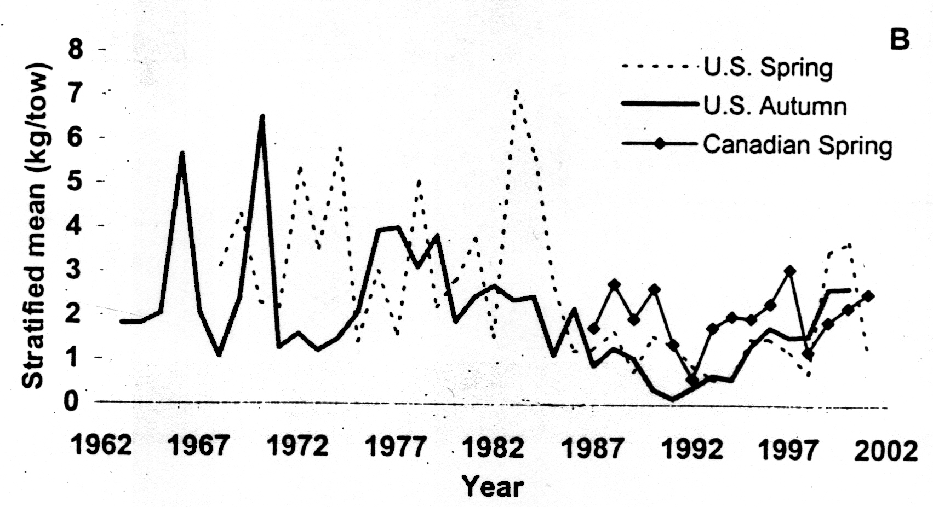
Scientific Survey Indices for Georges Bank Winter Flounder

Slide 13
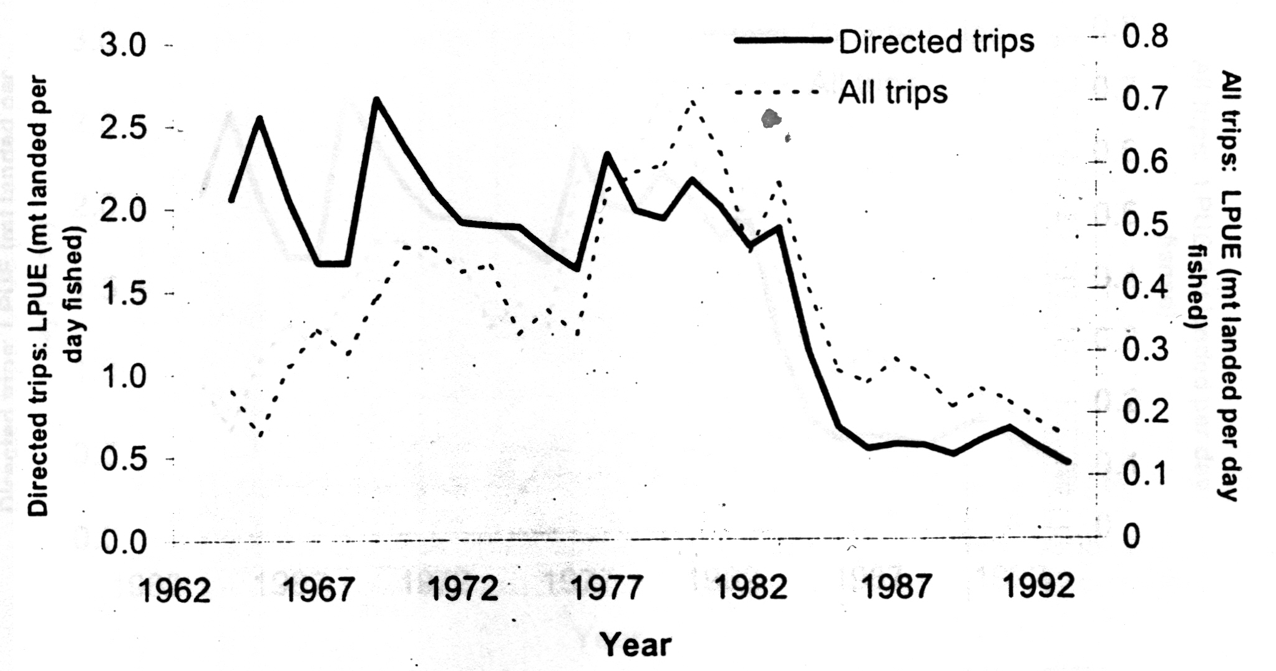
Landings per Unit Effort (LPUE) for Georges Bank Winter Flounder

Slide 14
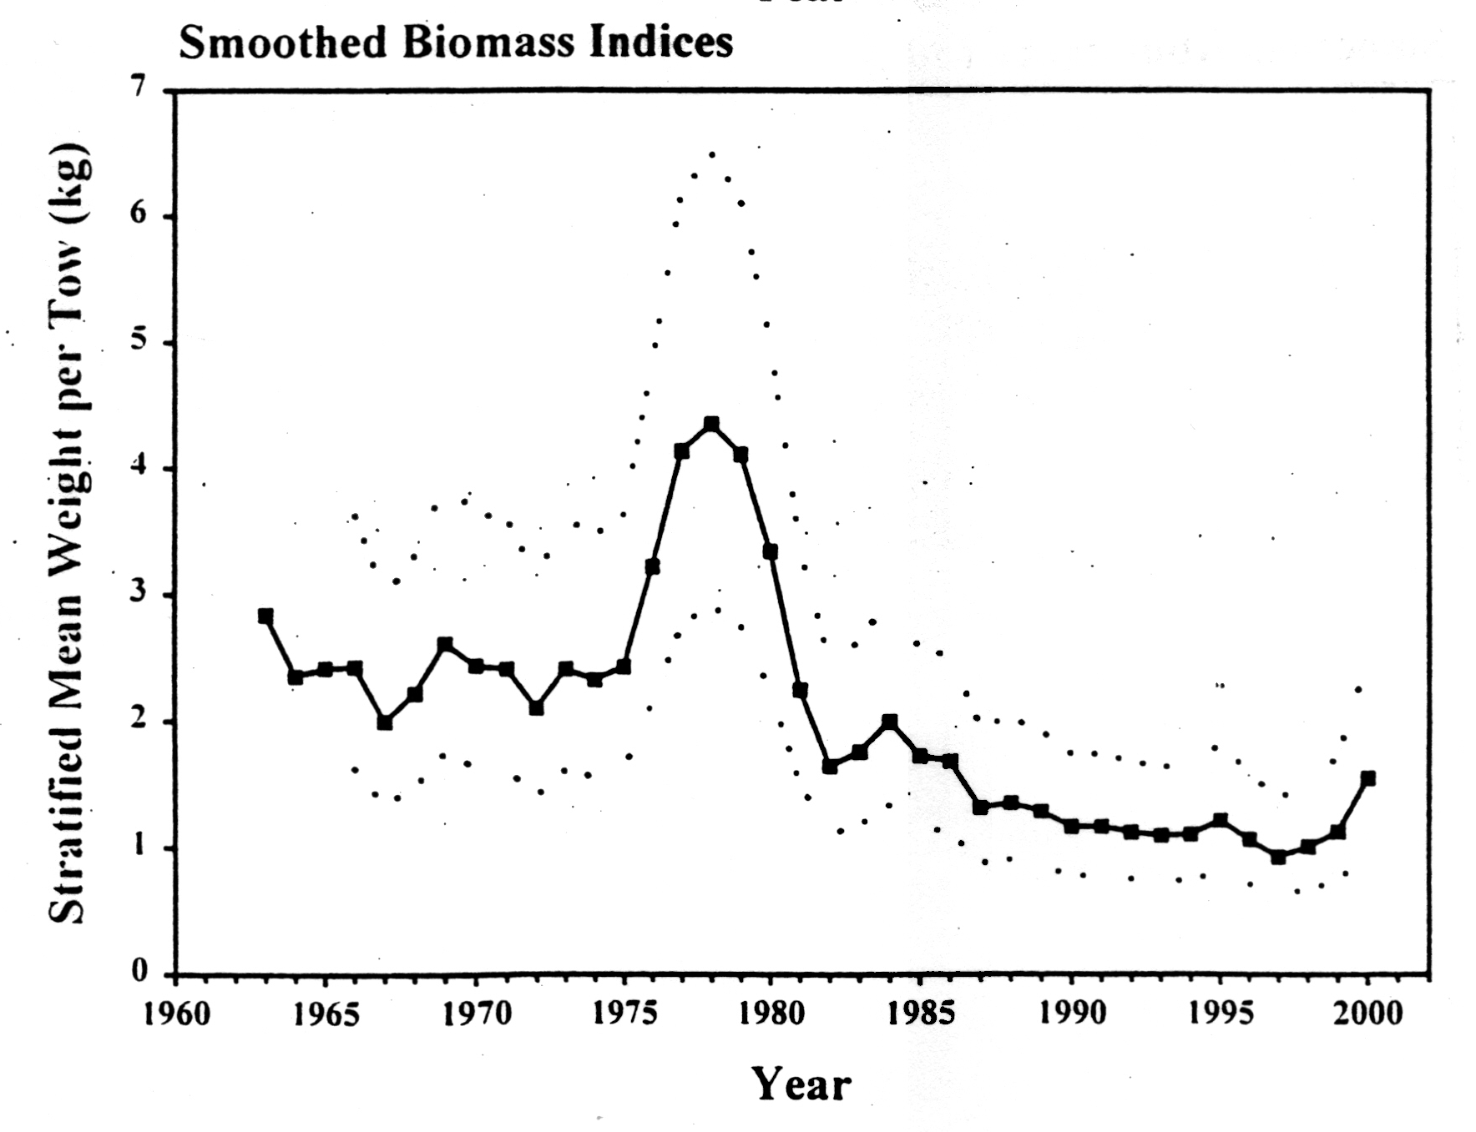
NEFSC Autumn Trawl Survey Index for Goosefish

Slide 15
Summary: Index Data
Index data is the minimum information that can be used in fish stock assessments.
Index data reference points generally refer to some minimum level of historical stock biomass from which the fish stock has previously recovered.
Uncertainity in index data is due to unaccounted for changes in the effort parameter from inconsistent performance of survey gear or non-standardized fishery effort.

Slide 16
YPR Models
Yield or catch is removed annually from the cohort biomass.
Total yield or catch is a function of F (fishing mortality rate) and age of entry into fishery.
YPR is the summed yield resulting from each year of the cohort’s existence divided by the number of recruits.

Slide 17
Factors Utilized in the
YPR and SSBPR Models
Biological - growth, maturity, and natural mortality.
Harvesting - age or size at entry into the fishery and fishing mortality.
Stock abundance – not included in model

Slide 18
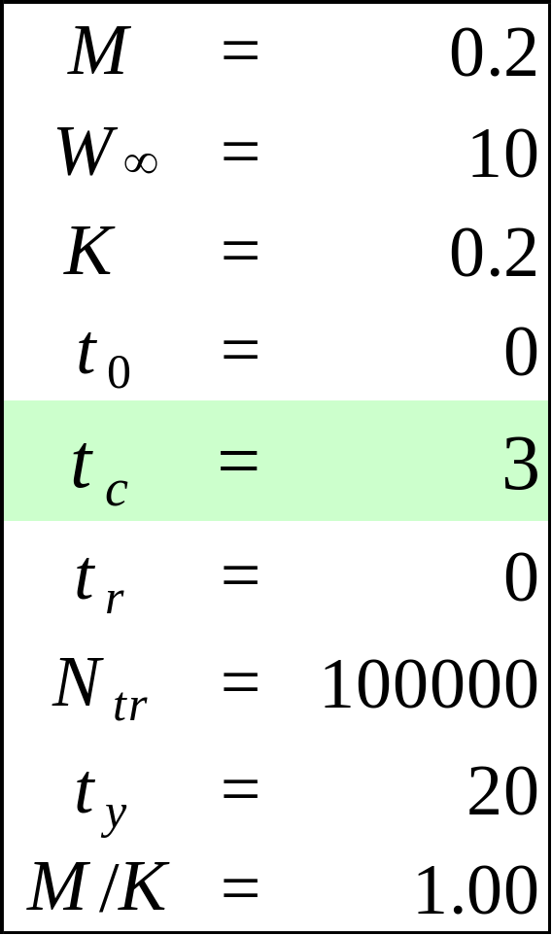
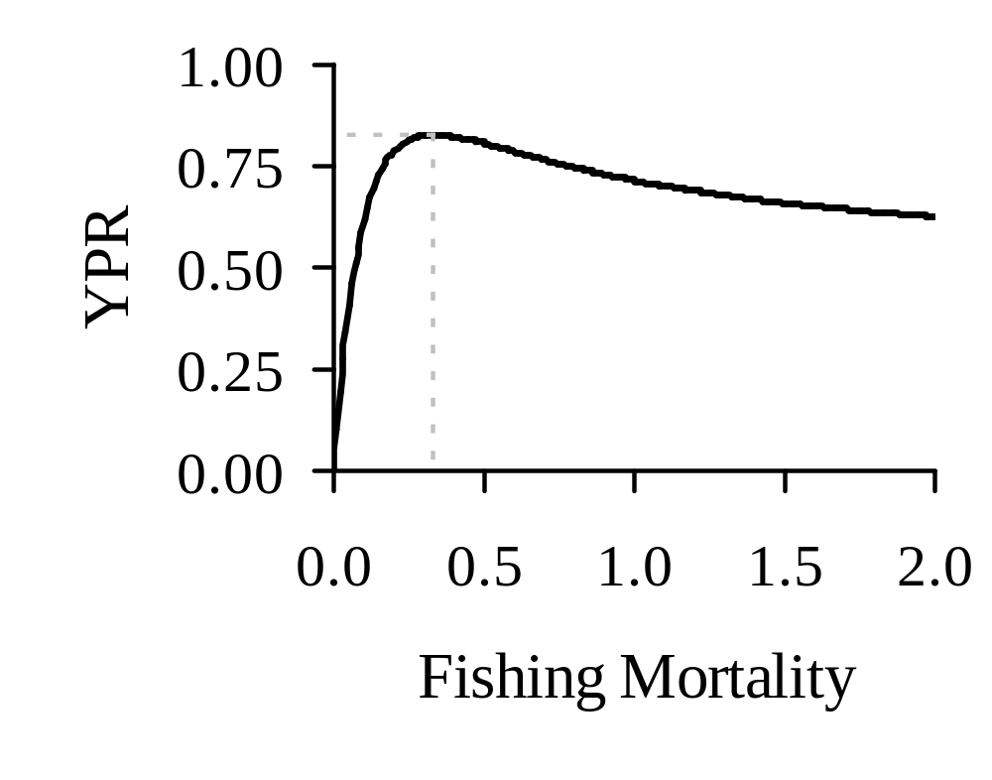
YPR as a Function of Fishing Mortality
YPR_{MAX} = 0.83
F_{MAX} = 0.33

Slide 19

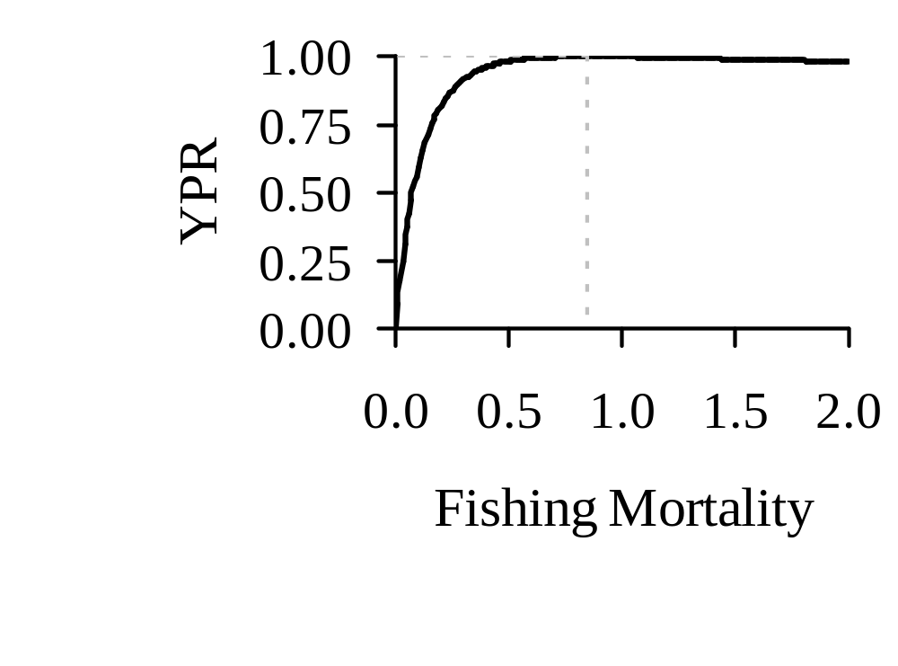
YPR as a Function of Fishing Mortality
YPR_{MAX} = 1.00
20% increase in YPR
F_{MAX} = 0. 85

Slide 20
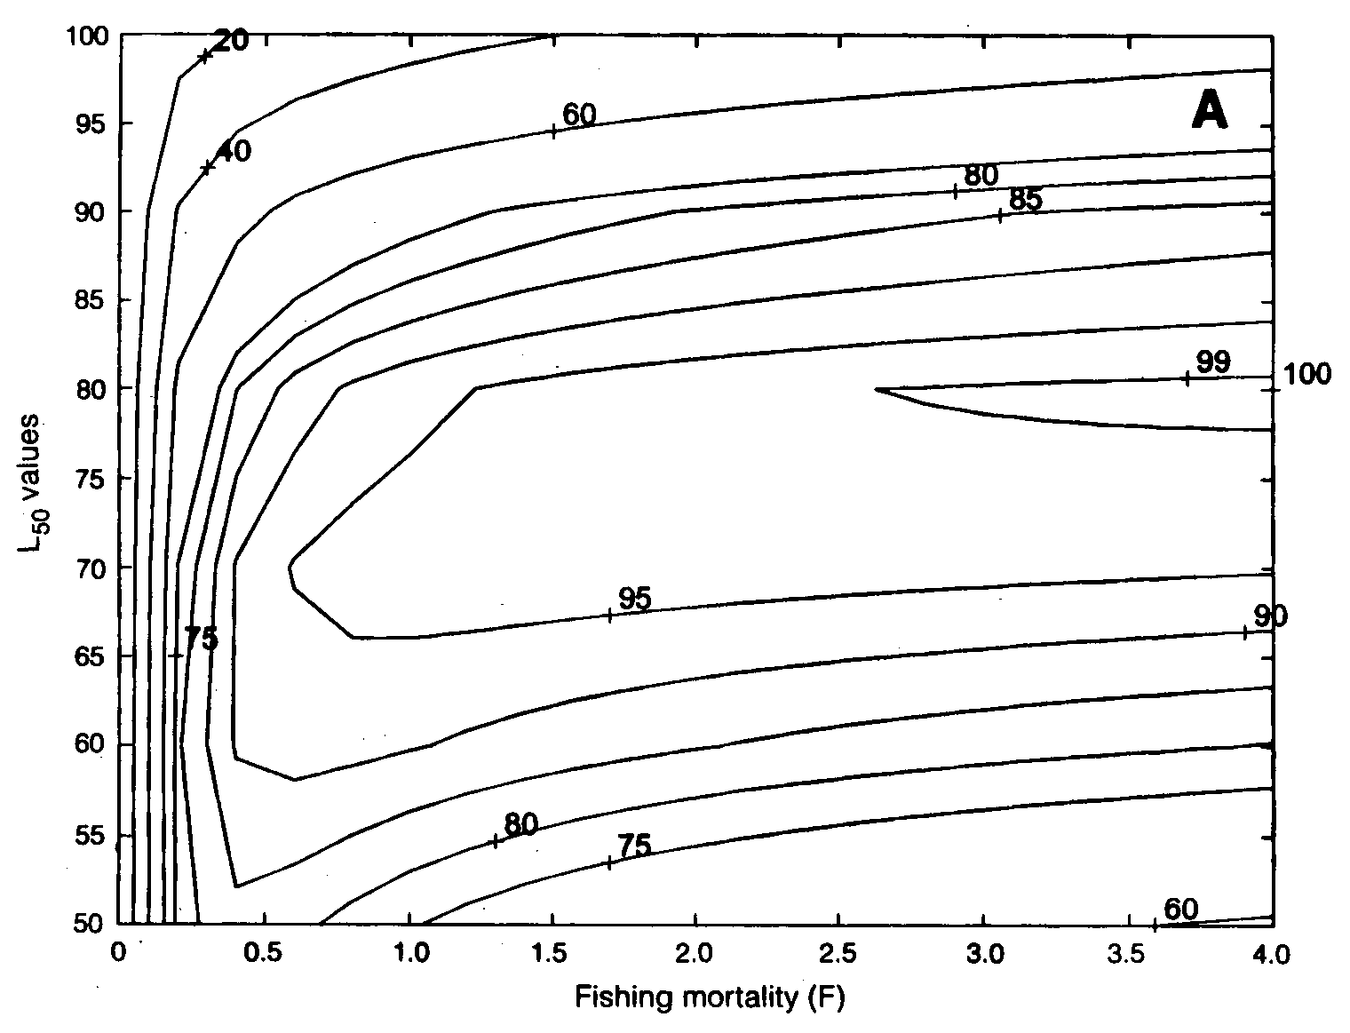
YPR Represented as an Isopleth Diagram

Slide 21
SSBPR Models
Spawning stock biomass per recruit is the cohort biomass remaining after the catch is removed, summed for all years, and divided by the number of recruits.
Spawning stock biomass is a function of F (fishing mortality rate) and the age of entry into the fishery.

Slide 22
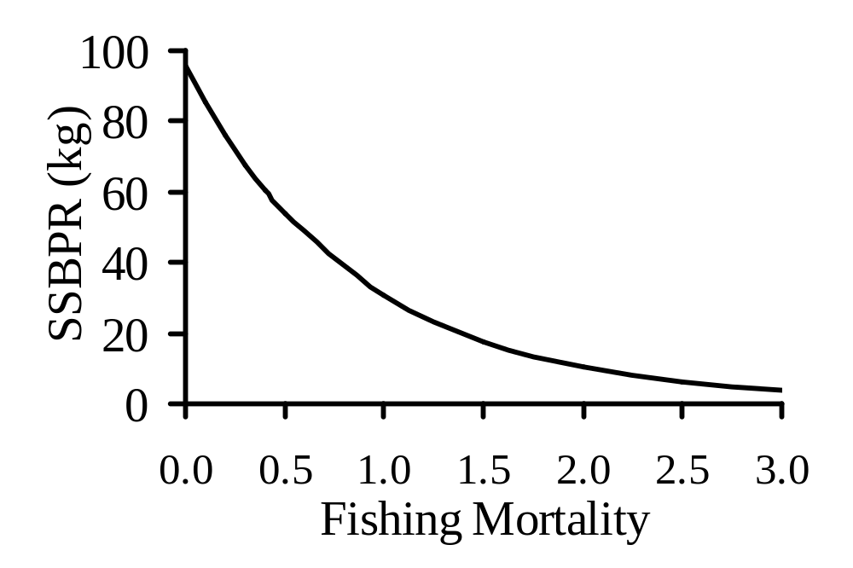
SSBPR as a Function of Fishing Mortality

Slide 23
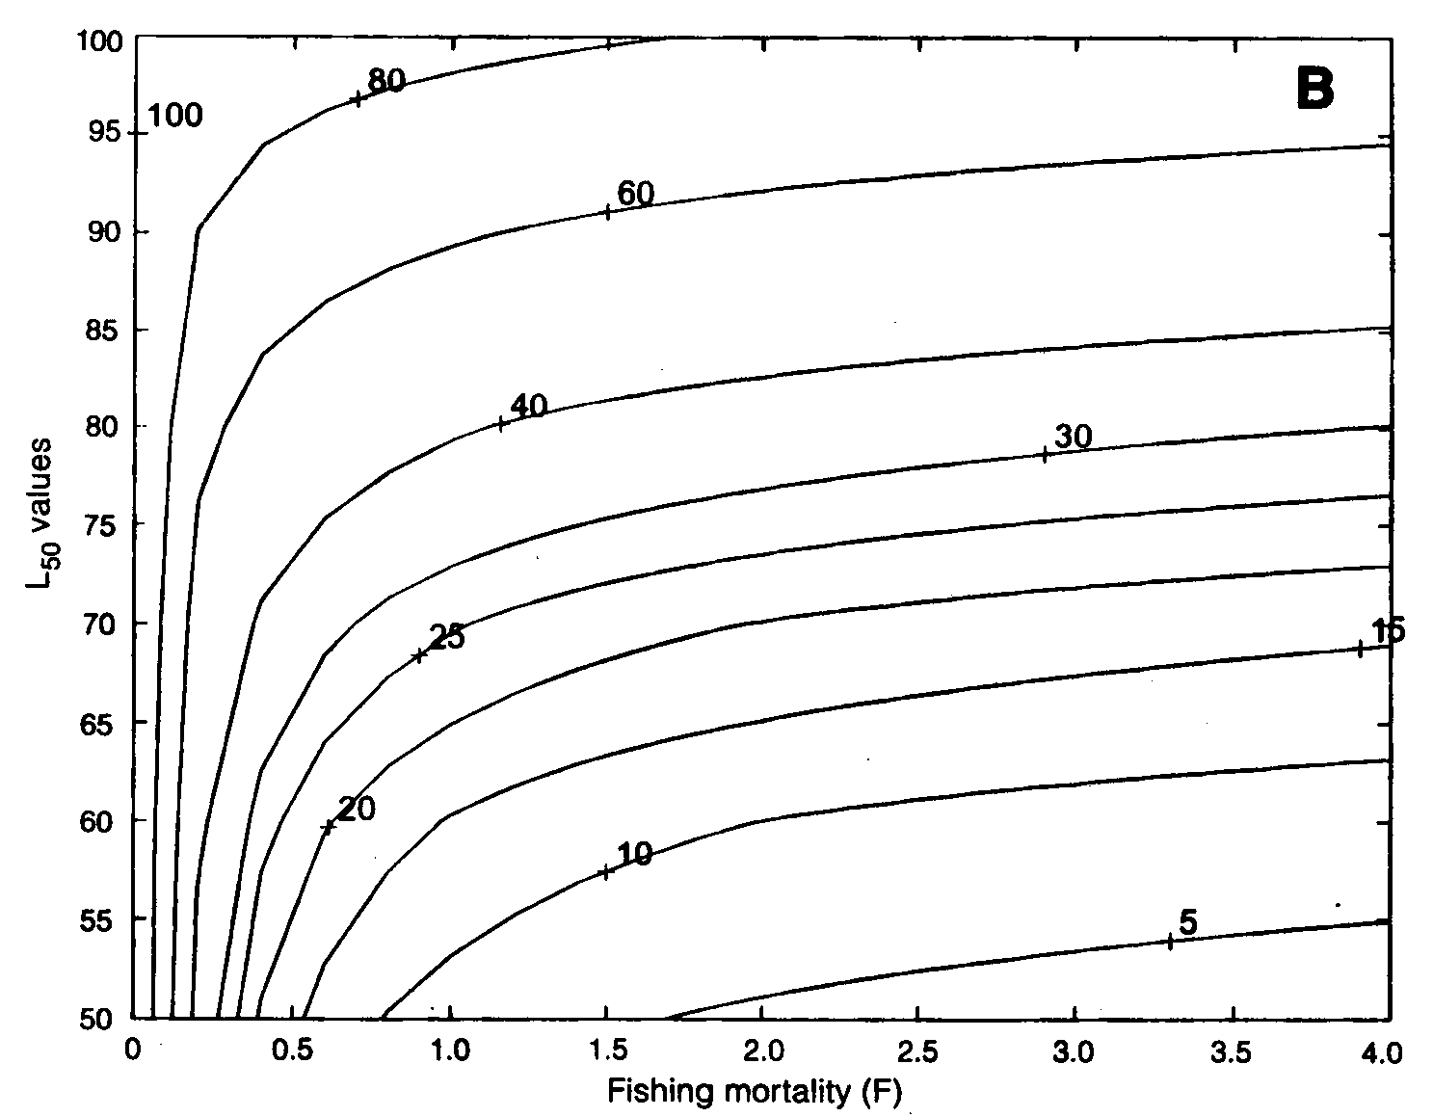
SSBPR Represented as an Isopleth Diagram

Slide 24
Yield and Growth Overfishing Management Reference Points
Y_{MAX} - maximum yield per recruit given a particular age or size of entry into the fishery.
F_{MAX} - fishing mortality rate that results in Y_{MAX} (usually a limit or threshold).
F_{0.1} - fishing mortality rate (based on a slope that is 10% of the initial slope) that results in production of 90+% of Y_{MAX} with considerably less effort (target).

Slide 25
Maintaining Reproductive Capacity and Recruitment Overfishing Management Reference Points
F_{5, 10, 20, or 30%} - fishing mortality rate that allows 5, 10, 20, or 30% of the virgin (unfished) spawning stock biomass to be conserved.
F_{target %} is always less than F_{limit %}

Slide 26
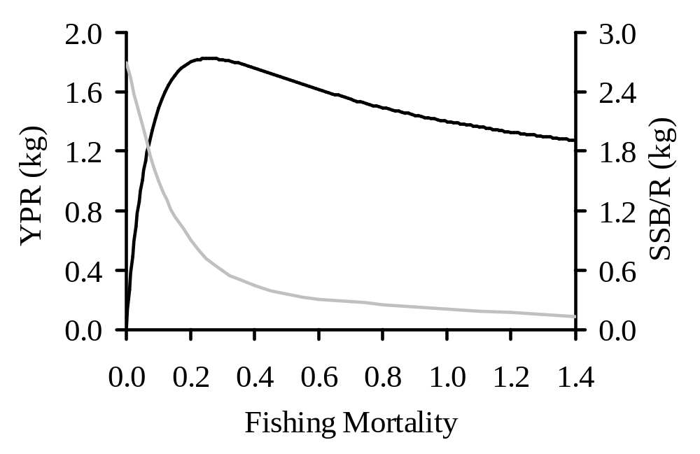
YPR and SSBPR as Reference Points
F_{MAX}
F_{0.1}
F_{20%SSBPR}
F_{10%SSBPR}

Slide 27
Examples of Reference Points from Fish Stock Assessments
Blue Crab
American Lobster
Summer Flounder
Bluefish

Slide 28
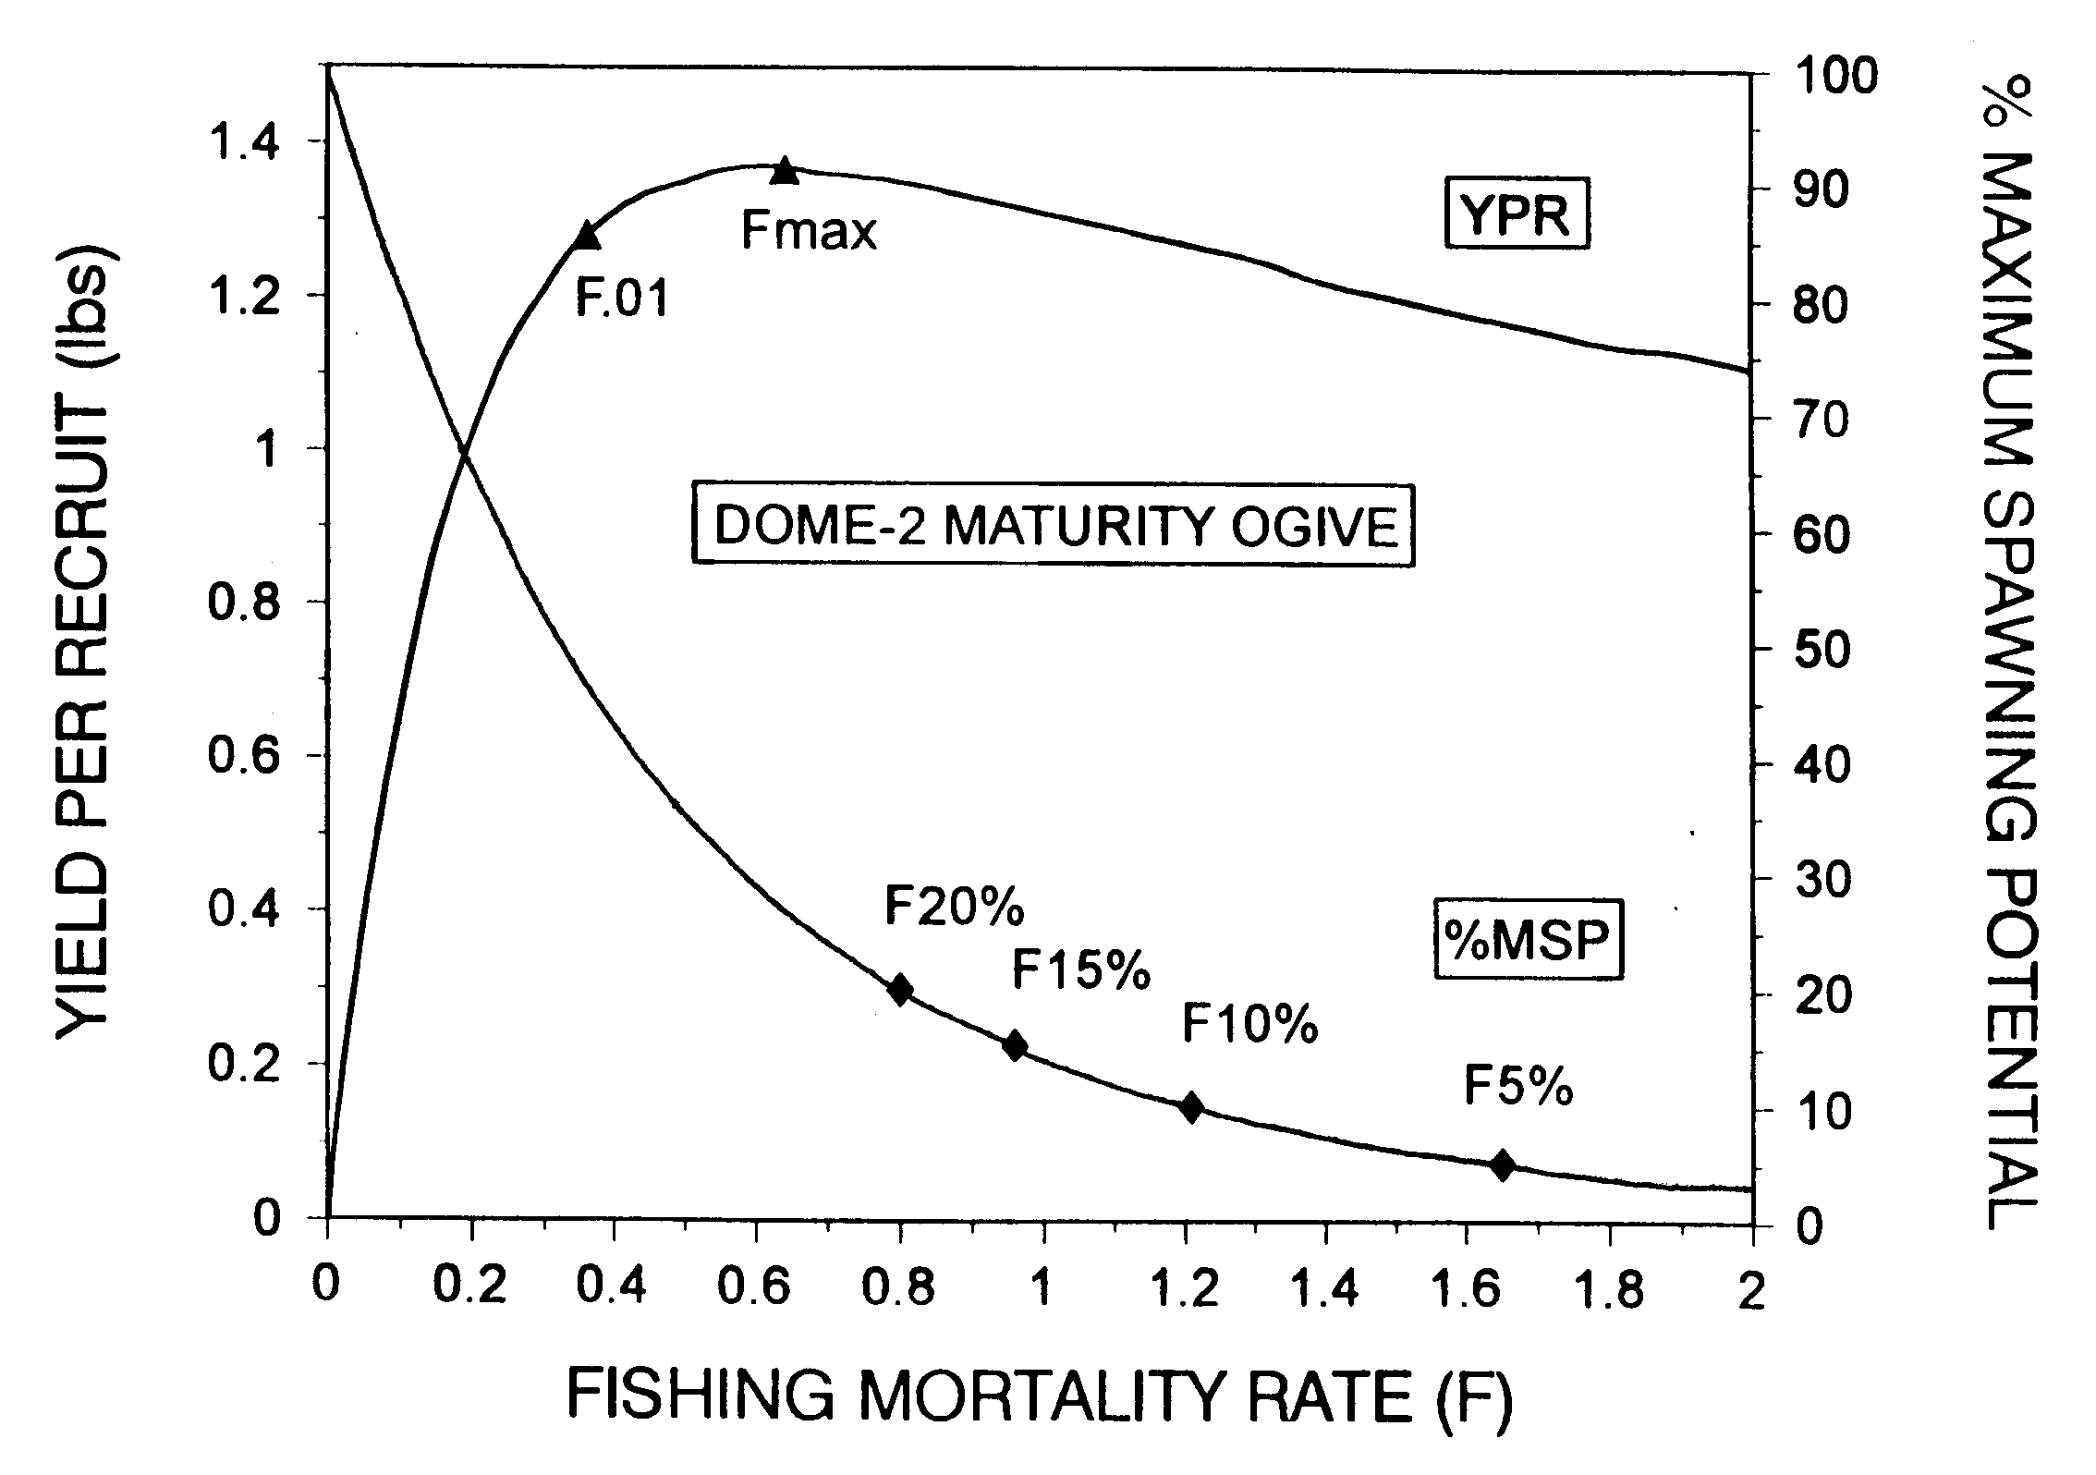
Blue Crab YPR and SSBPR

Slide 29
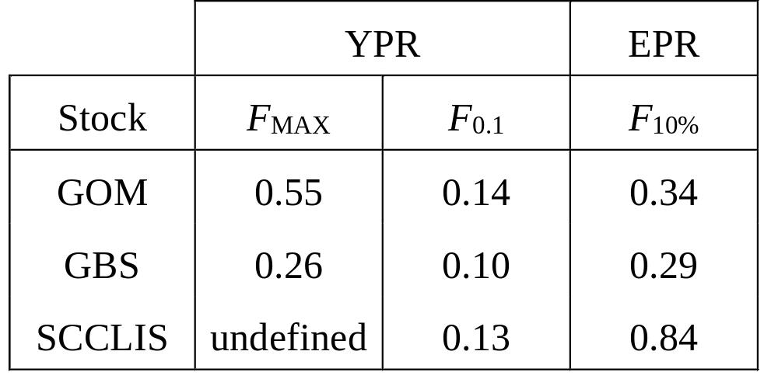
American Lobster Reference Points

Slide 30
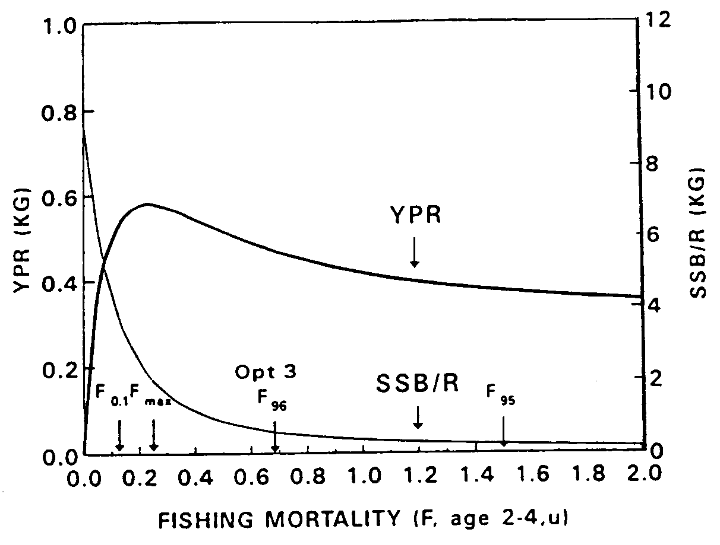
Summer Flounder YPR and SSBPR

Slide 31
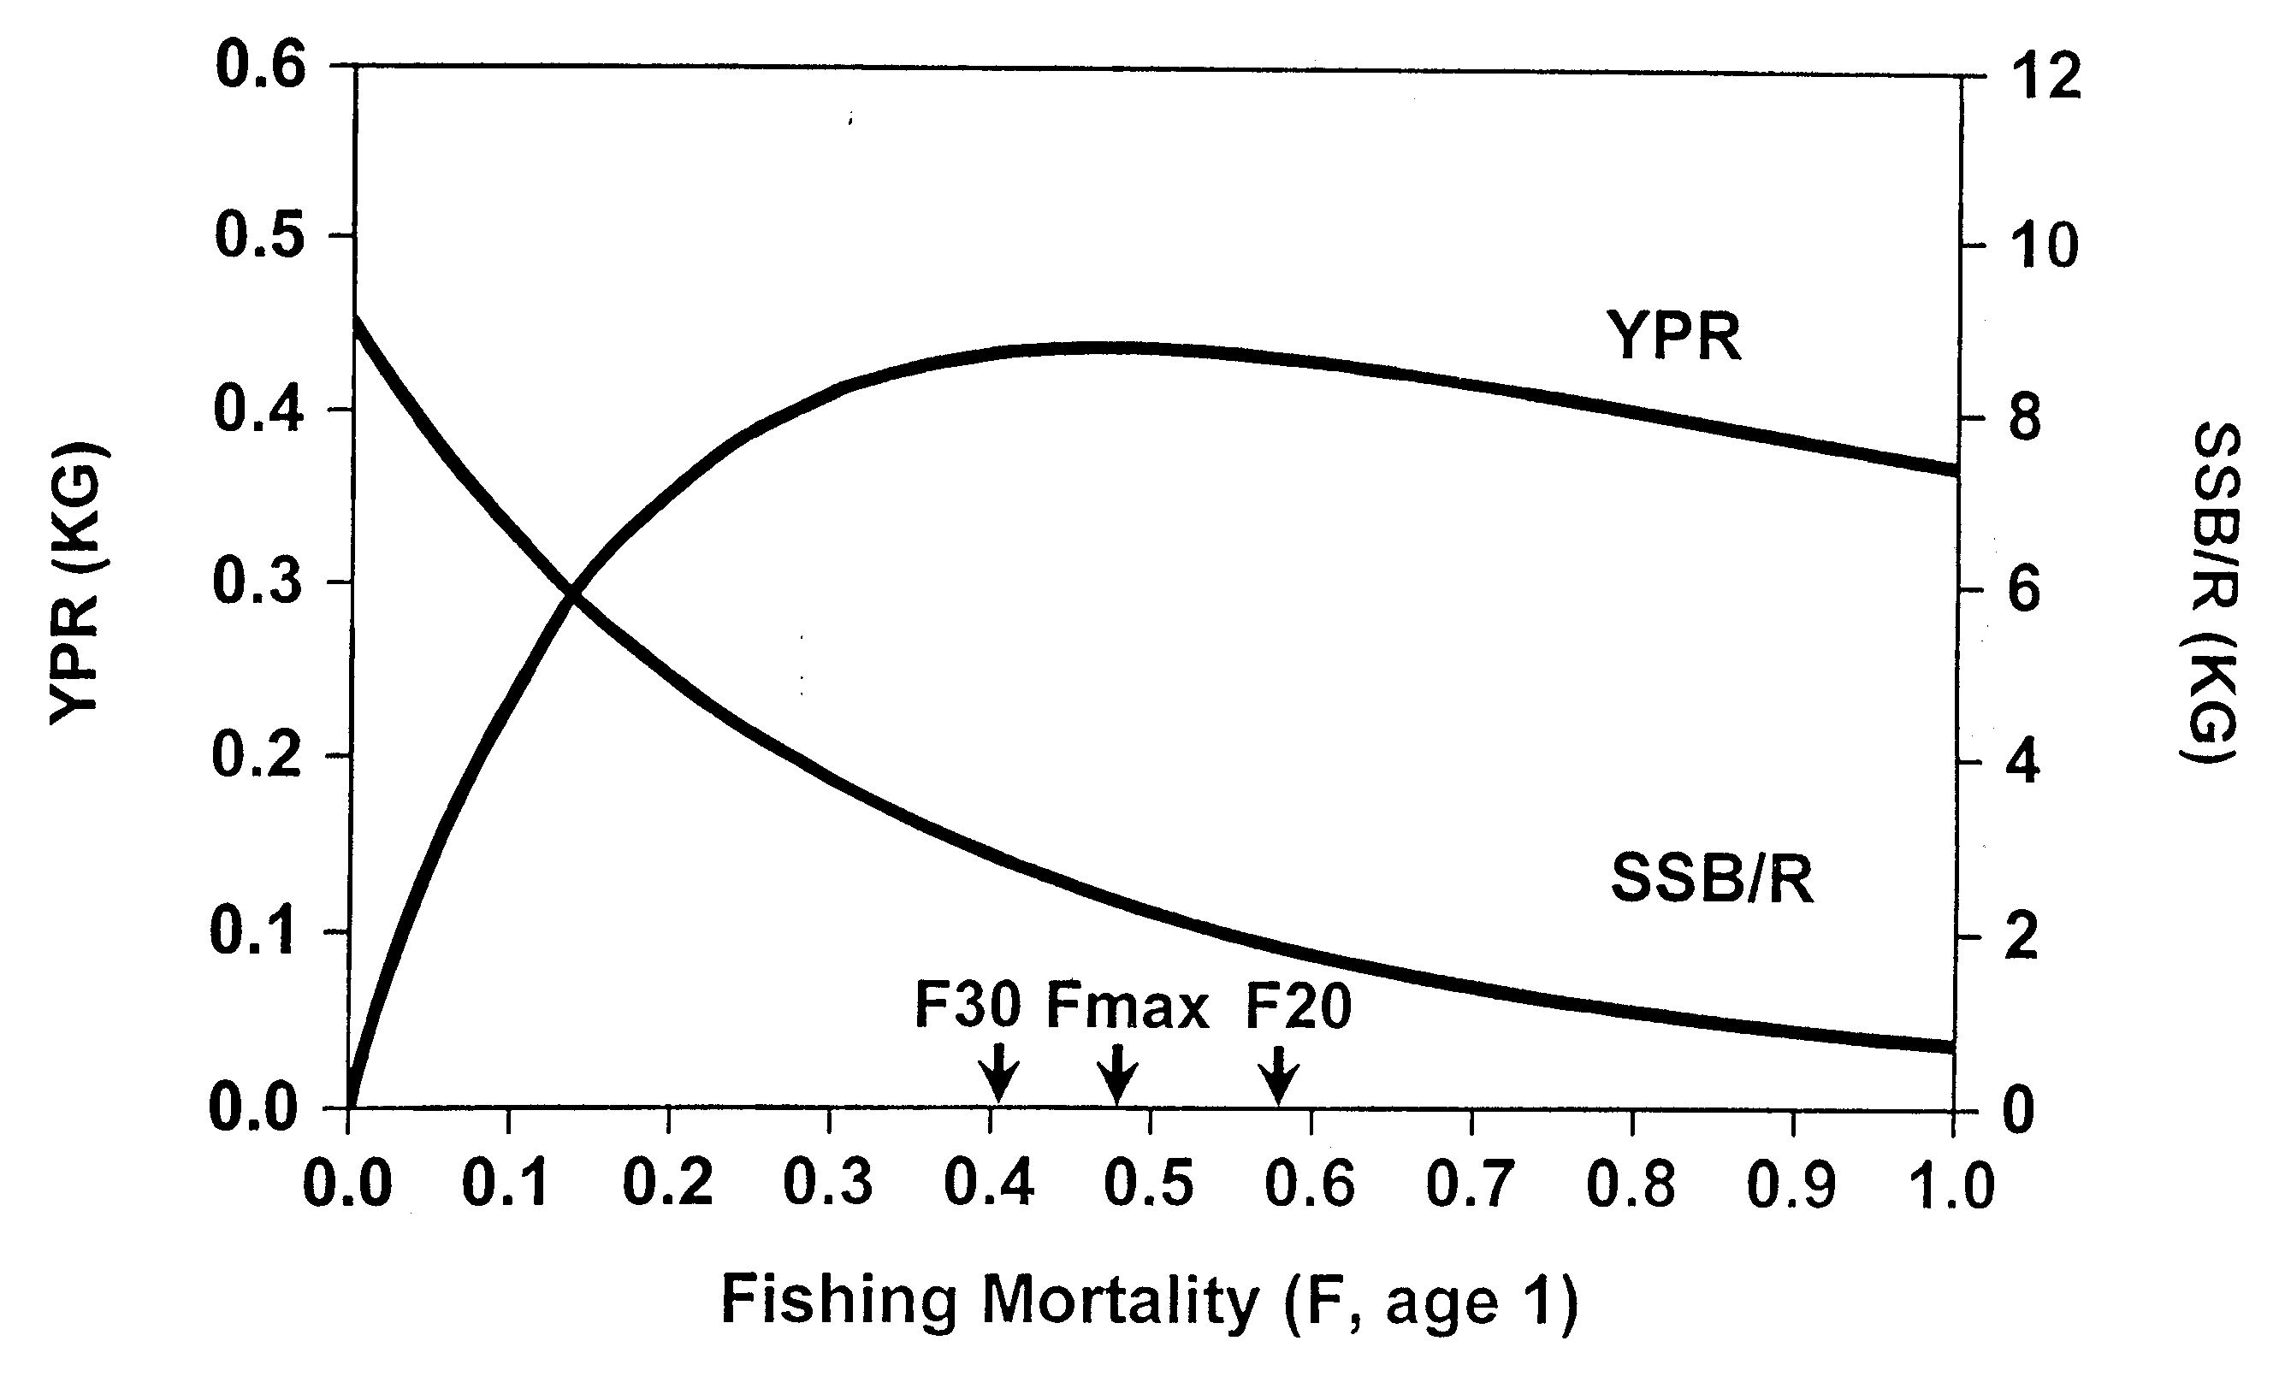
Bluefish YPR and SSBPR

Slide 32
Summary: YPR and SSBPR Models
YPR and SSBPR models provide insight into biological processes and result in reference points to compare present fishing mortality rates against.
YPR and SSBPR models are based on scientific principles.
Input parameters are based on scientific data with uncertainty.
Selection of reference points is based on both science and policy.

Slide 33
Surplus Production Model:
Basic Concept
New Biomass = Old Biomass + Recruitment +
Growth - Catch - Natural Mortality
New Biomass = Old Biomass + Surplus Production – Catch
At equilibrium: New Biomass = Old Biomass
∴ Catch = Surplus Production

Slide 34
Characteristics of Surplus Production Models
Equilibrium and non-equilibrium models.
Global model: does not distinguish between recruitment, growth, and mortality.
Not structured: does not consider age or length groups.
Utilize biomass instead of number for ecological considerations.

Slide 35
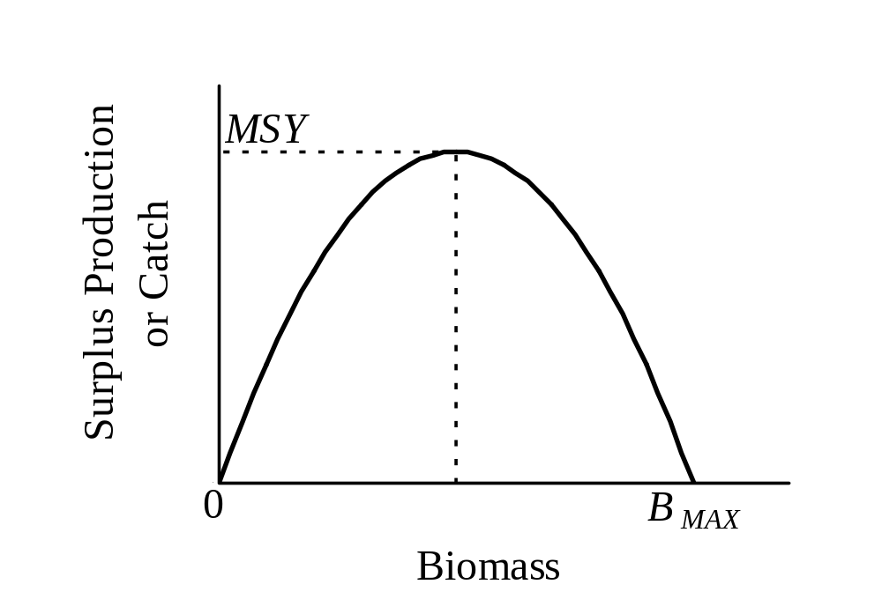
Surplus Production Model

Slide 36
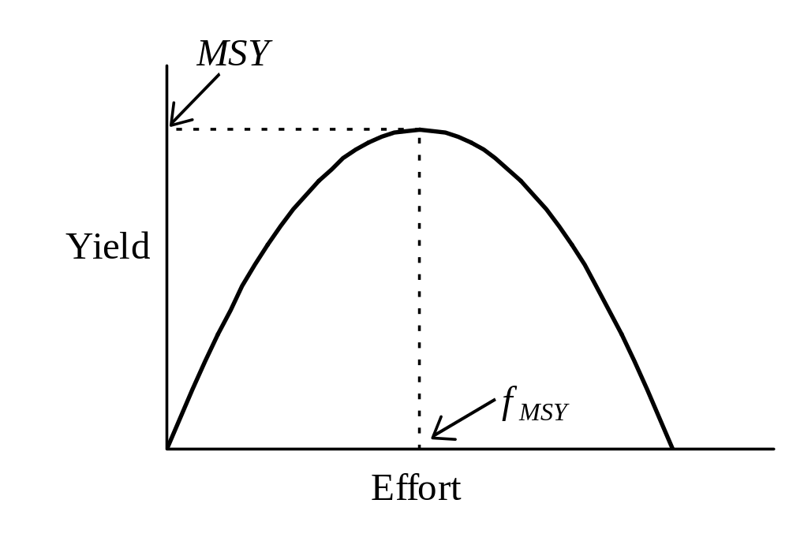
Schaefer (1954) Model

Slide 37
Reference Points from Surplus Production Models
MSY – maximum sustainable yield, largest average catch that can be taken continuously from a stock under average environmental conditions.
B_{MSY} – the level of stock biomass that will produce MSY.
f_{MSY} – the level of fishing effort that will produce MSY.
²/₃ f_{MSY} – a precautionary target used so as to avoid overfishing, generally provides greater than 85% MSY.

Slide 38
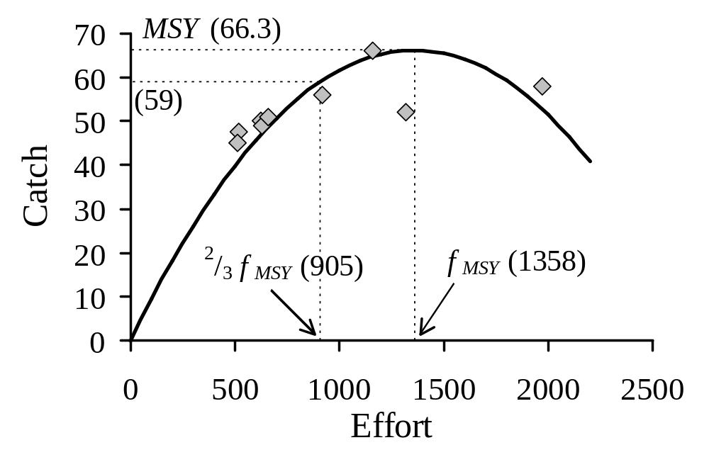
Non-linear Schaefer Model Best Fit to the Catch and Effort Data

Slide 39
Limitations of Equilibrium Surplus Production Models
Fish stocks are rarely at equilibrium due to environmental variability and stock abundance fluctuation.
Equilibrium models usually overestimate MSY and f_{MSY} whenever applied to data collected on a stock in decline, i.e. during development of the fishery.
MSY and f_{MSY} post stock rebuilding are substantially lower than those predicted based on data collected during the process of fishing down an accumulated biomass.

Slide 40
Examples of Surplus Production Models from Fish Stock Assessmnets
Lobster
Bluefish
Blue Crab
Summer Flounder

Slide 41
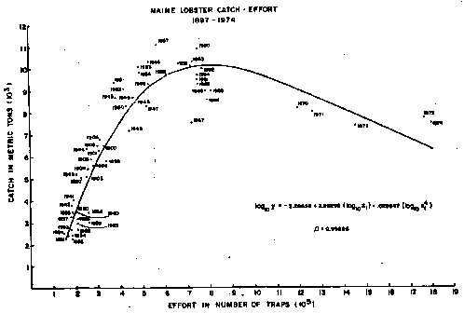
Maine Lobster Catch-Effort
1897-1974
Notes:
Catch and effort data for the Maine lobster fishery from the period 1897 to 1974 demonstrated the classic curve that depicts increasing yield with increasing effort until some maximum is reached, after which increases in effort produce declining yields.
In more recent years the yield curve for the Maine lobster fishery has turned upwards again, in spite of increasing effort. But there are questions about the comparability of data. For example, if the fishing grounds expanded, the curve would no longer hold.

Slide 42
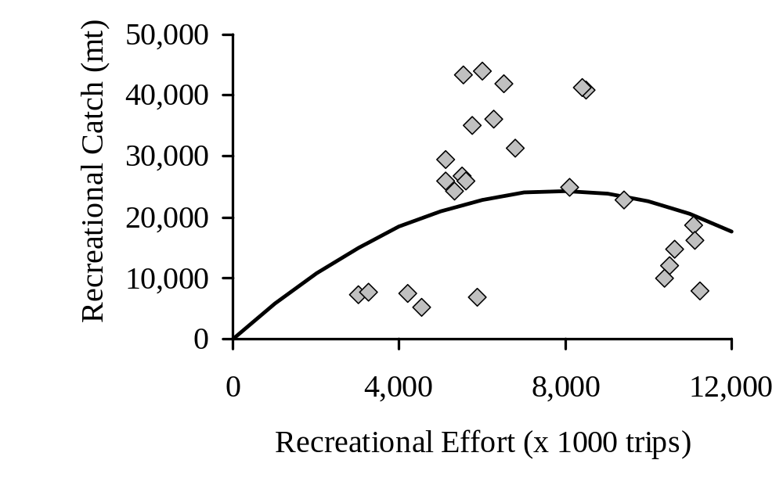
Schaefer Model for Bluefish (1974 – 1999)

Slide 43
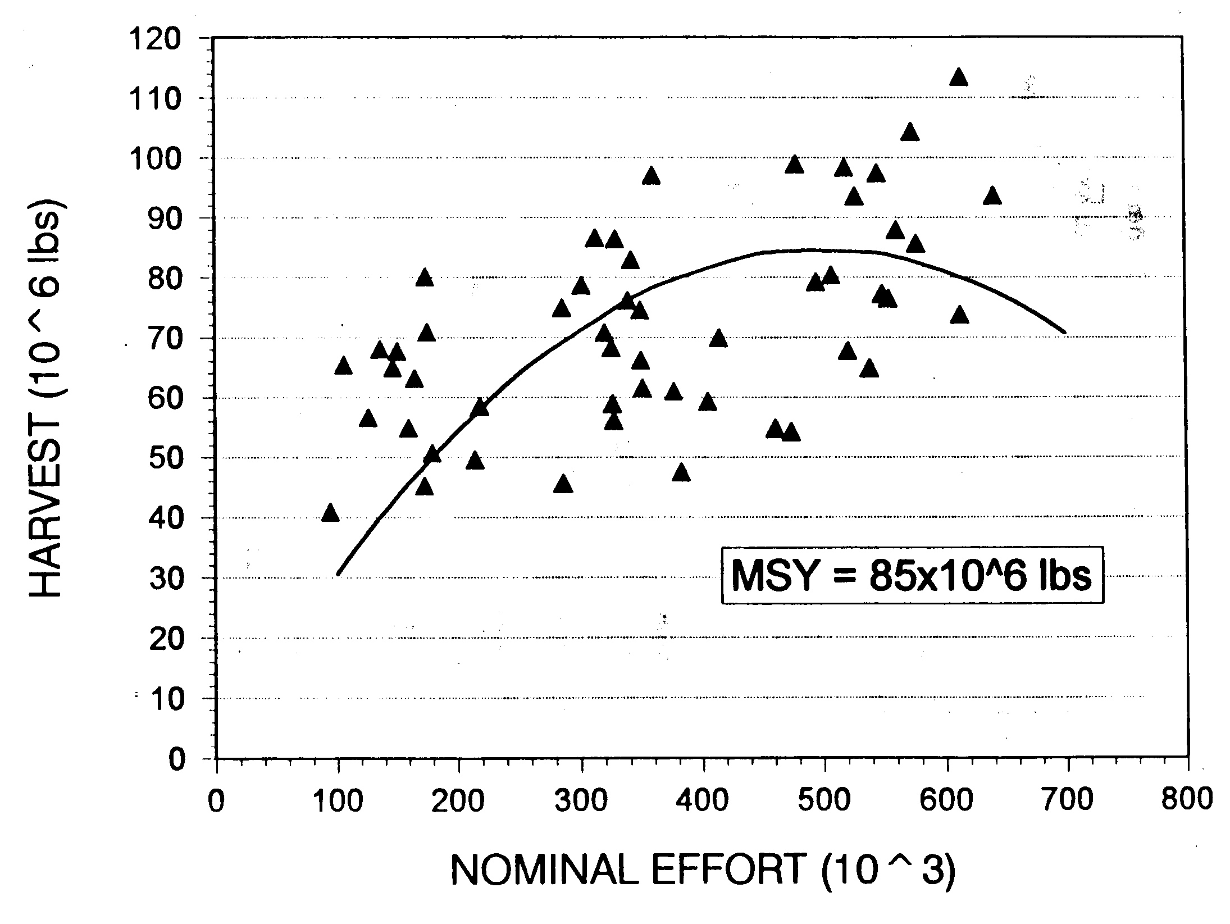
Schaefer Model for Blue Crab (1945 – 1995)

Slide 44
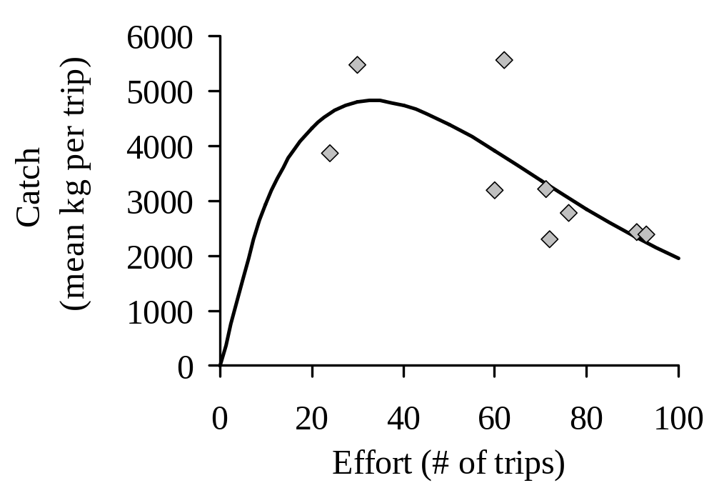
Fox Model for Summer Flounder from the North Carolina Winter Trawl Fishery (1982 – 1990)

Slide 45
Summary: Surplus Production Models
Maximum production and therefore maximum catch is possible only at mid-range population size.
Biological reference points are MSY, B_{MSY}, and f_{MSY}.
Equilibrium surplus production models must be applied cautiously as they tend to overestimate MSY and f_{MSY}.

Slide 46
Stock-Recruitment Models
Predict number of recruits at a future date based on estimates of present spawning stock abundance.
Provide a rationale for regulating fishing mortality so as to avoid low stock sizes that may lead to recruitment failure and stock collapse.

Slide 47
Biological Processes Governing S-R Relationships
Density independent survival at low stock size.
Density dependent survival (compensation) at high stock size.

Slide 48
Spawning Stock is Measured By:
Number of females alive at each age times fecundity at age,
Number of individuals alive at each age times fecundity at age,
Total biomass of individuals at or above the age of first reproduction, or
Index of abundance of the population in the year eggs are deposited

Slide 49
Recruitment is measured by:
Recruits to the fishery determined by Virtual Population Analysis (VPA) from catch-at-age data and
Juvenile/ pre-recruit surveys

Slide 50
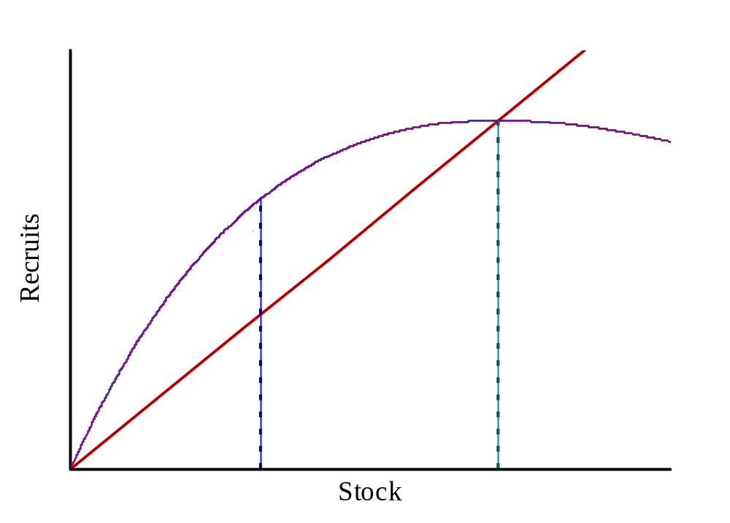
Stock-Recruitment Relationship Showing B_{MSR} and B_{O} Reference Points

Slide 51
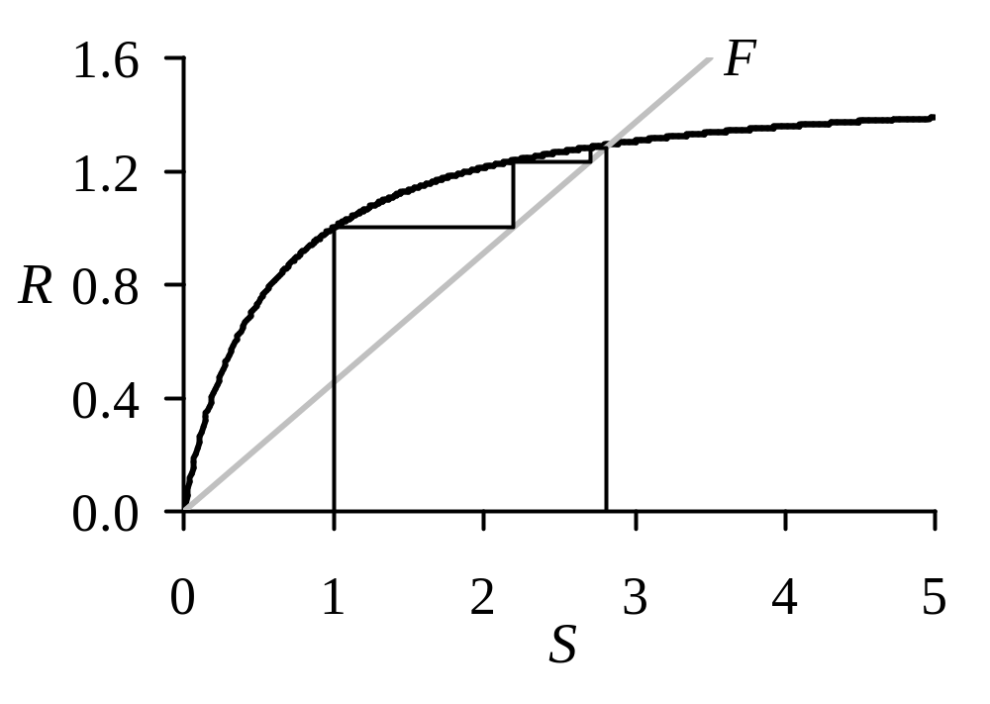
Two-Stage Life History Trajectory Based on the Intersection of S-R and SSBPR Relationships

Slide 52
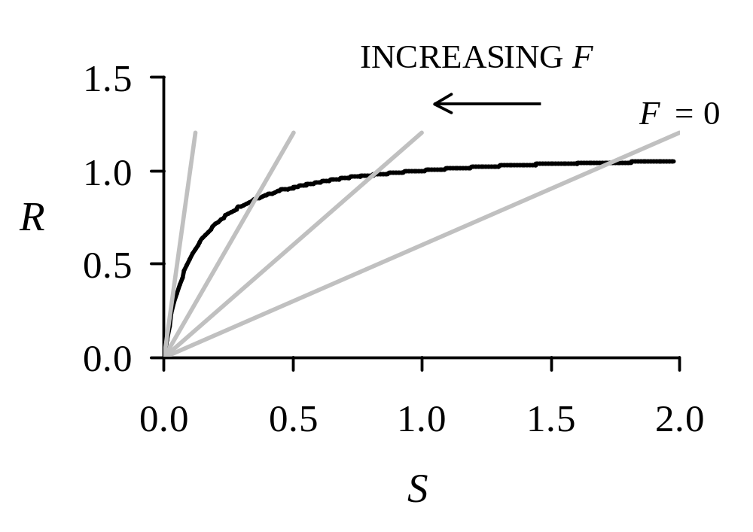
Intersection of SSBPR Functions at Various Fishing Mortality Levels (F) with a Beverton-Holt S-R Relationship

Slide 53
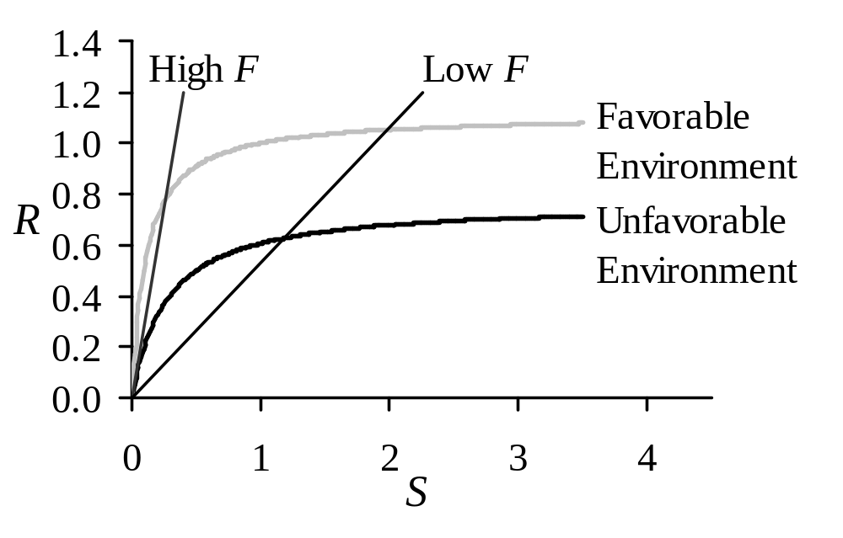
Effect of Environmental Suitability on the S-R and SSBPR Relationships

Slide 54
Examples of Stock-Recruitment Relationships from Fish Stock Assessments
      Blue Crab
      Shad
      others

Slide 55
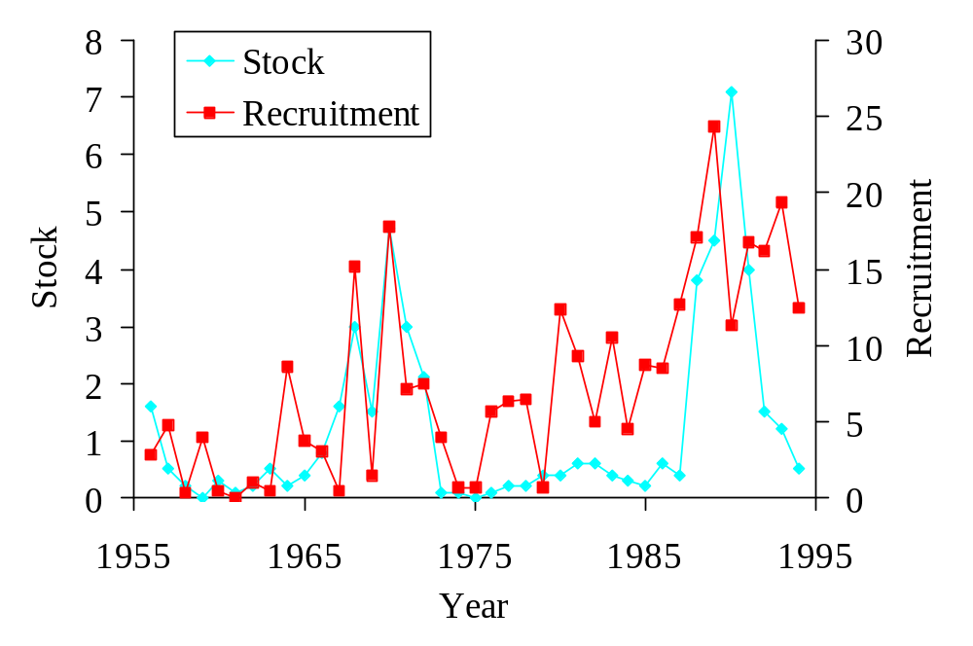
Blue Crab: Stock-Recruitment Time Series

Slide 56
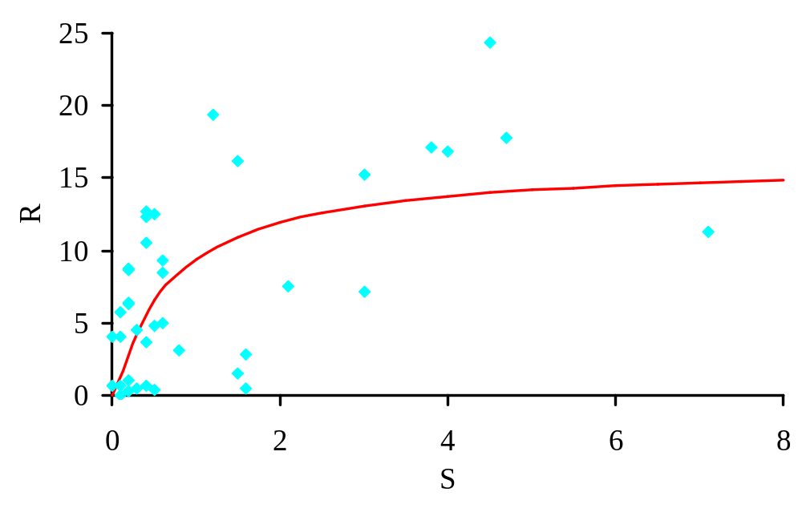
Blue Crab: Stock-Recruitment Relationships

Slide 57
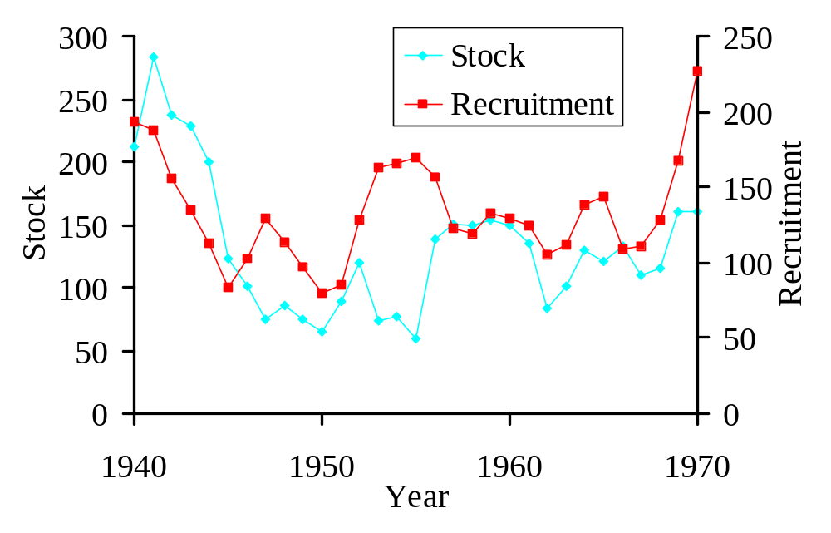
Shad: Stock-Recruitment Time Series

Slide 58
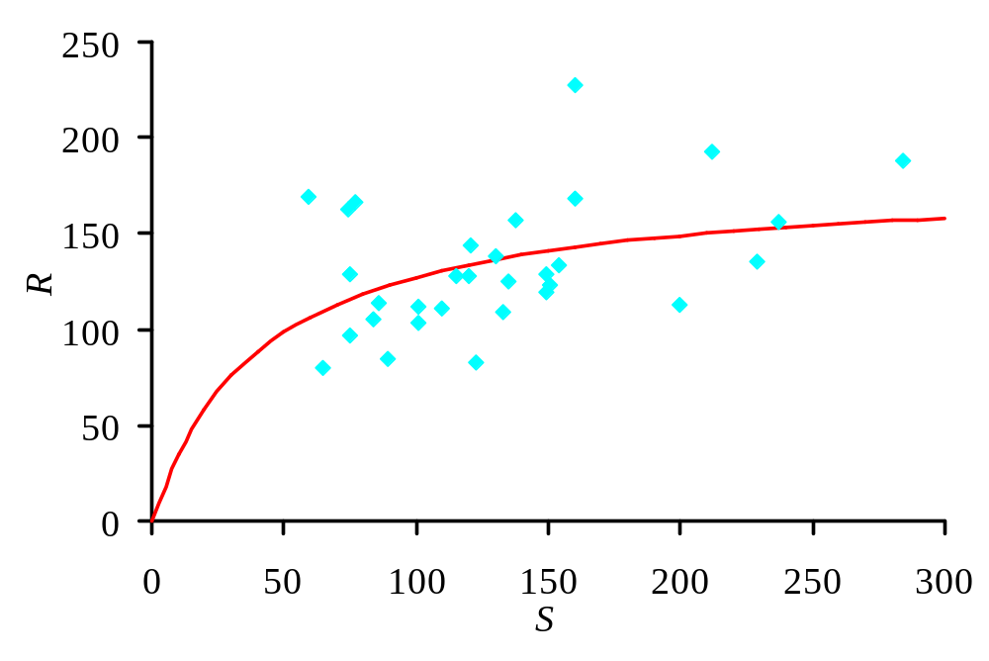
Shad: Stock-Recruitment Relationship

Slide 59
Summary: Stock-Recruitment Models
  Stock-recruitment relationships are often difficult to discern.
  Environmental factors have a substantial effect on recruitment success.
  Stock-recruitment reference points refer to the minimum stock level that produces sufficient recruitment to sustain a healthy stock

Slide 60
Age-Length Structured Models
Provide estimates of past and present fishing mortality and stock abundance.
However, by themselves these models do not provide unique insight into stock or fishery processes, and therefore do not provide reference points.

Slide 61
Harvest Control Rules
Use pre-agreed protocols controlling fishing mortality with respect to stock status and threshold reference points.
Optimize harvest control is designed to achieve MSY under prevailing ecological and environmental conditions.
Optimum yield from a fishery stock will be sustainably achieved when existing biomass exceeds B_{MSY}(B/B_{MSY}>=1) and when fishing mortality is less than F target or less than F_{MSY}(F/F_{MSY}<=1).

Slide 62
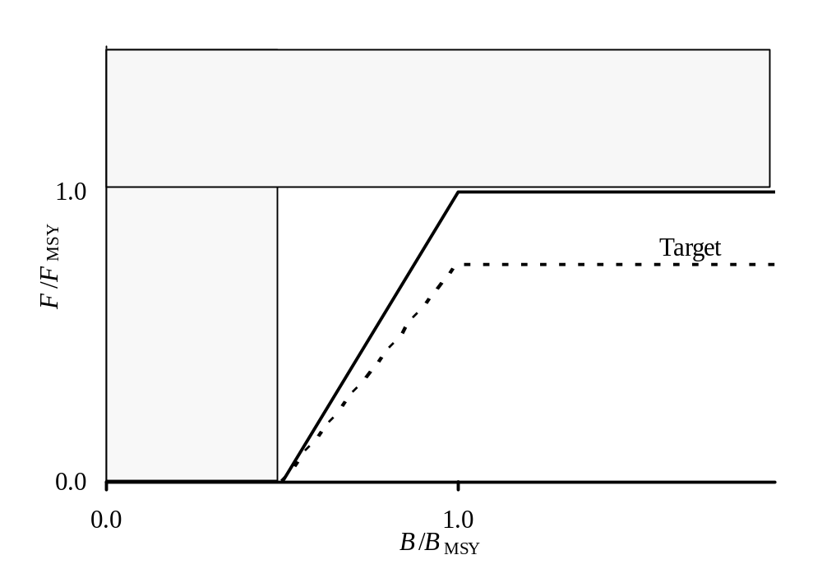
Harvest Control Rule Based on Biomass Levels Relative to B_{MSY} and Fishing Mortality Rates Relative to F_{MSY}

Slide 63
Examples of Harvest Control Rule
      Georges Bank winter flounder
      Blue crab
      others

Slide 64
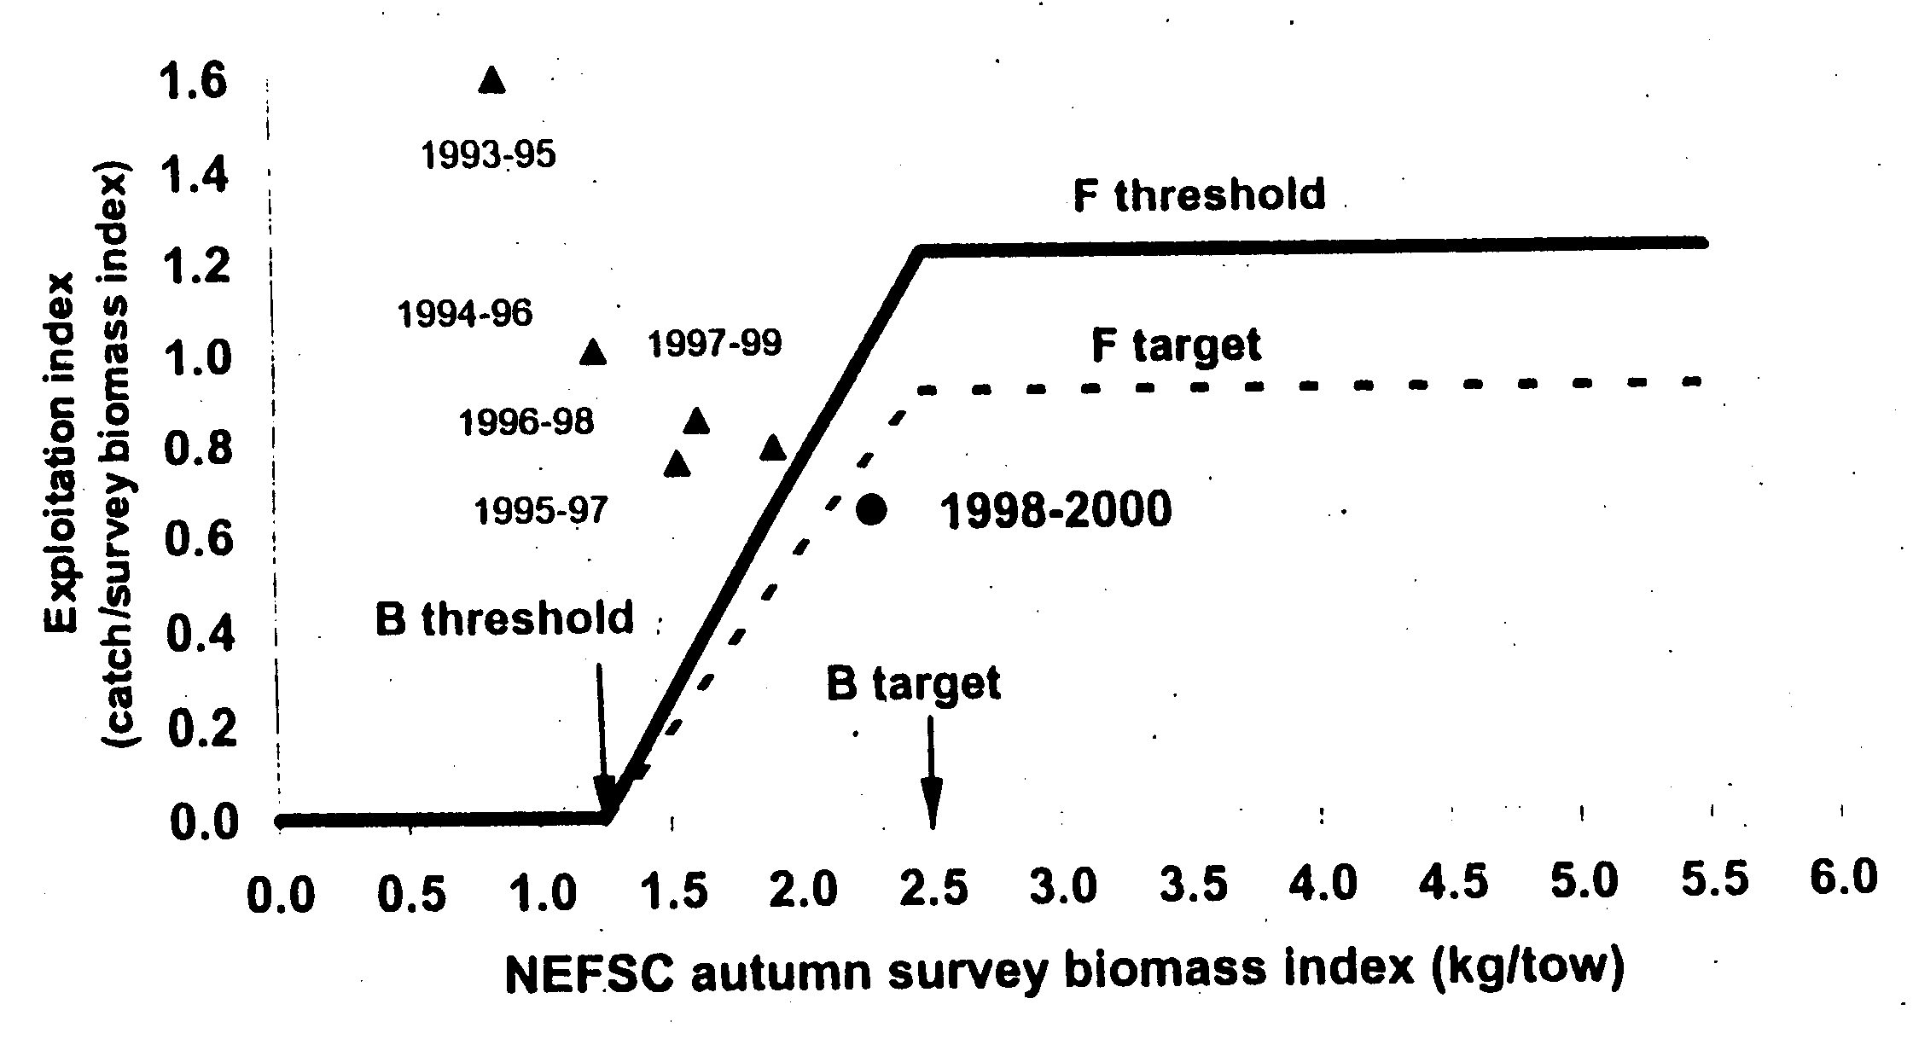
Harvest Control Rule for Winter Flounder

Slide 65
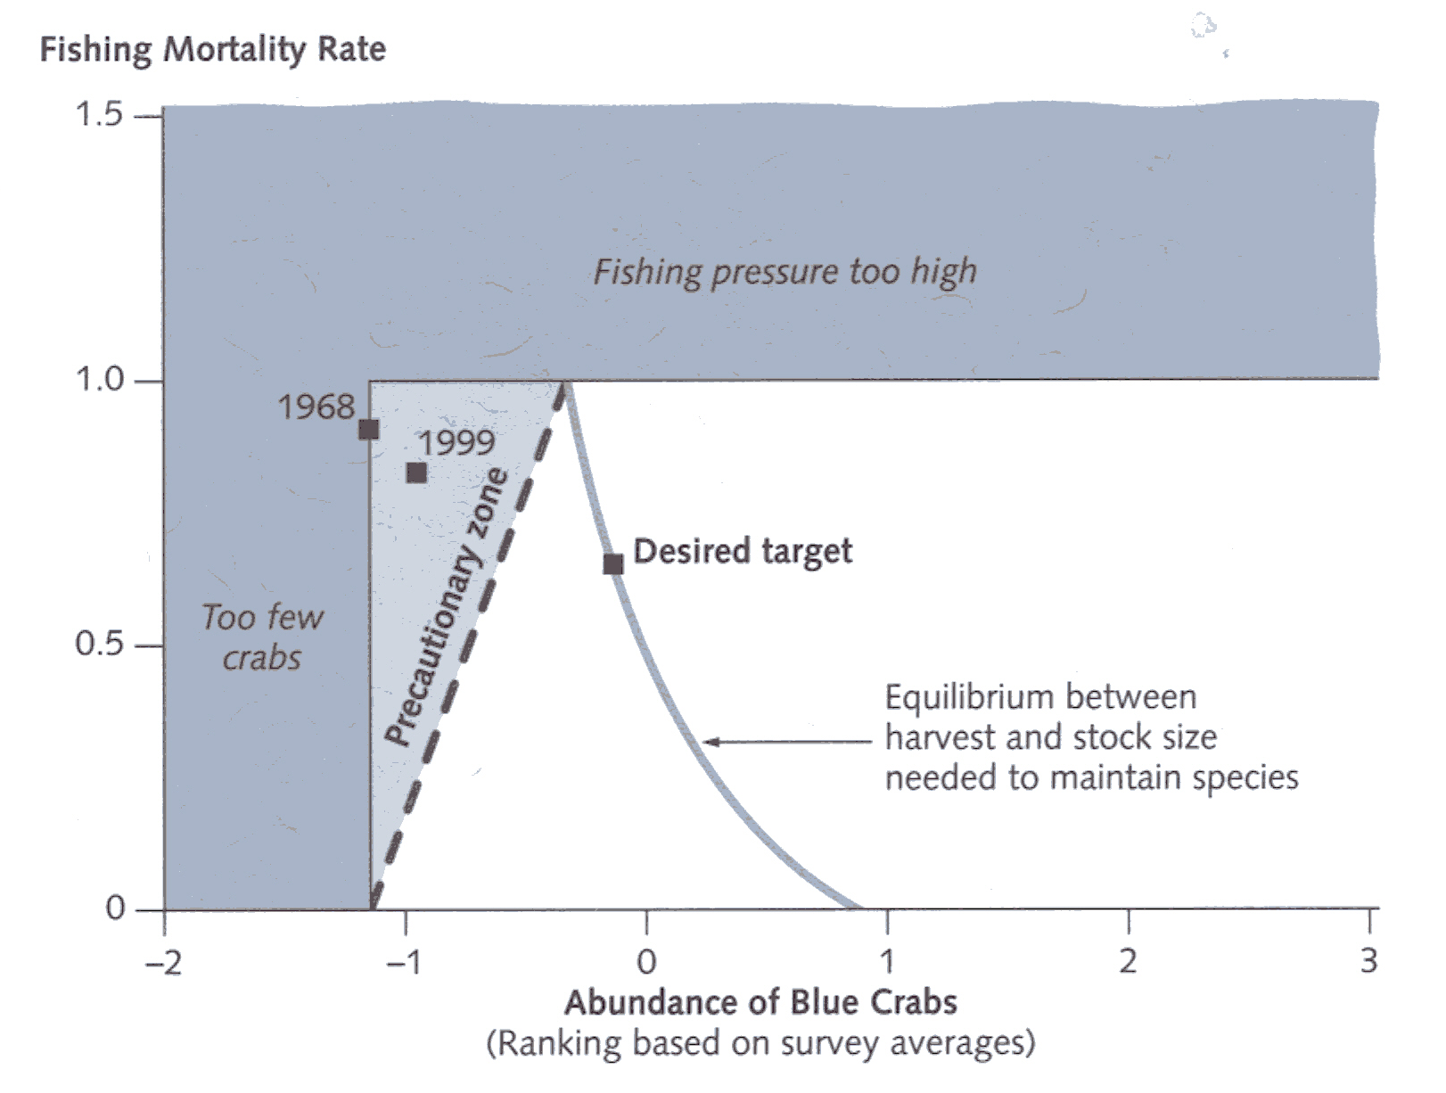
Harvest Control Rules for Blue Crab

Slide 66
Summary of Harvest Control Rule
  Harvest control rules allow for the simultaneous evaluation both the stock abundance and fishing mortality relative to predetermined standards.
  Useful to conceptually and visually monitor the decline and/or recovery of a fish stock.

Slide 67
Summary and Conclusions
Reference points provide objective criteria to evaluate the current levels of stock status and fishing mortality against.
Index data provide an historical index of relative stock abundance and a relative minimum reference point.
YPR and SSBPR models provide fishing mortality reference points for growth and recruitment overfishing.

Slide 68
Summary and Conclusions
Surplus production models provide reference points for stock abundance and fishing mortality so as to achieve MSY.
Stock-recruitment models provide a reference point relative to a minimum stock abundance required to ensure adequate future recruitment.
Harvest control rules compare both fishing mortality and stock abundance to predetermined standards to evaluate status of the stock and fishery.

